Slide 1
India Demographics
Analysis
Dataset Theme
• Demographic profile by age, gender and location
• State-wise respondent distribution
• Education and employment breakdown
• Income patterns across categories
• Internet, bank and insurance access indicators
RECORDS
STATES
AVG INCOME
10,000
10
₹5.01L
sample persons
covered states
annual income
Source: powerbi_india_demographics_sample.csv

Slide 2
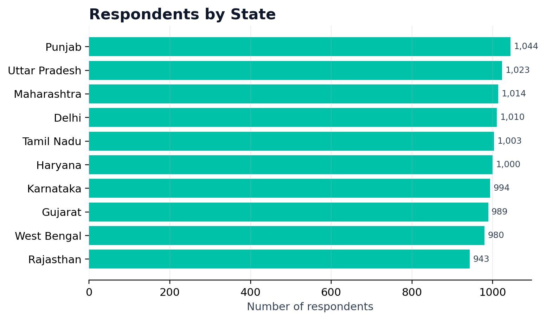
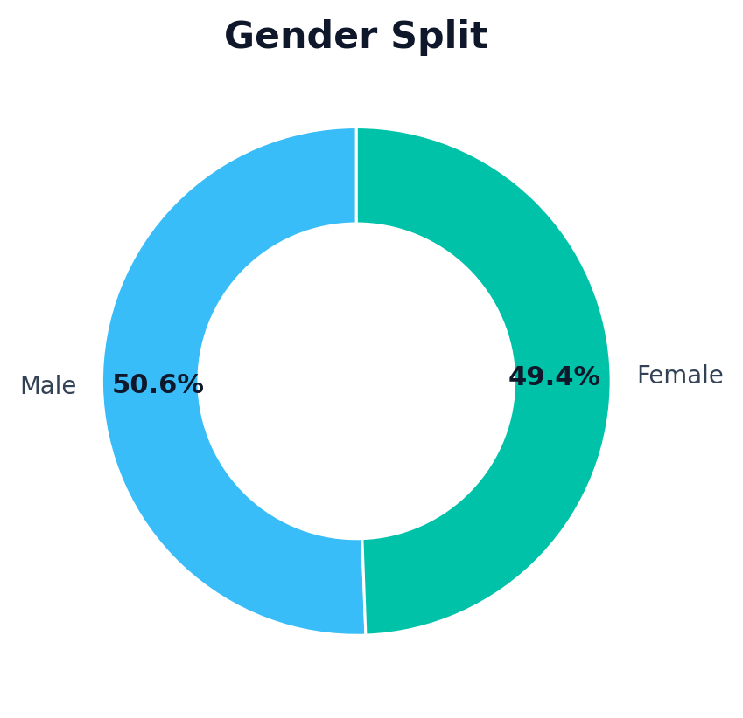
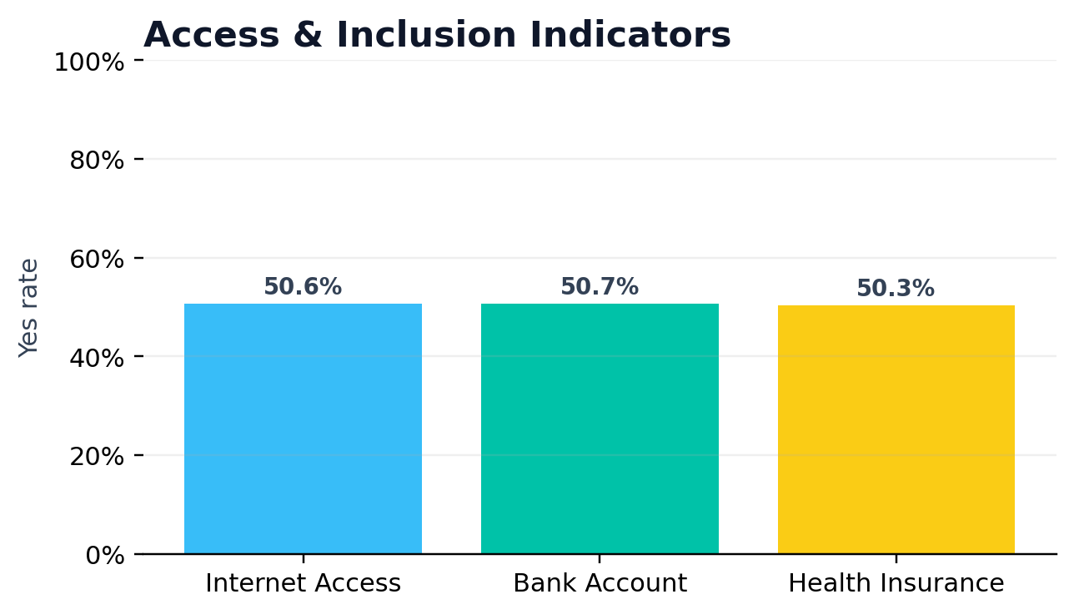
Executive Summary Dashboard
India demographics sample
TOTAL RECORDS
AVG AGE
MEDIAN INCOME
AVG HOUSEHOLD
MISSING VALUES
10,000
49.1
₹4.94L
4.49
0
complete rows
median 49
annual
members
data quality
State-wise sample coverage
Gender balance
Inclusion overview
Source: powerbi_india_demographics_sample.csv | Sample analysis for presentation
02

Slide 3
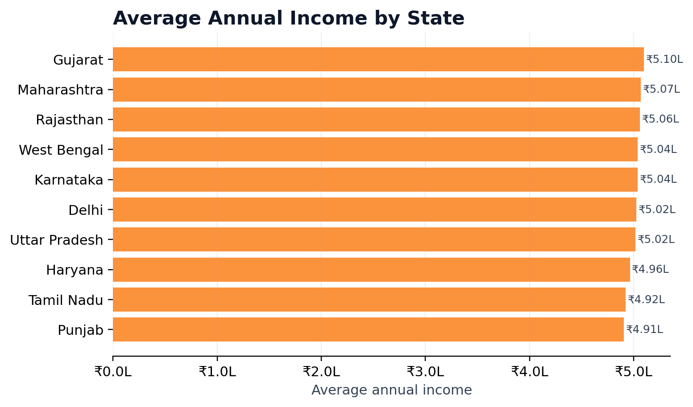
Geographic Distribution
State-level sample view
Respondents by State
Average Annual Income by State
Insight: Punjab has the highest representation in the sample (1,044 records), while Gujarat shows the highest average annual income at ₹5.10L.
Source: powerbi_india_demographics_sample.csv | Sample analysis for presentation
04

Slide 4
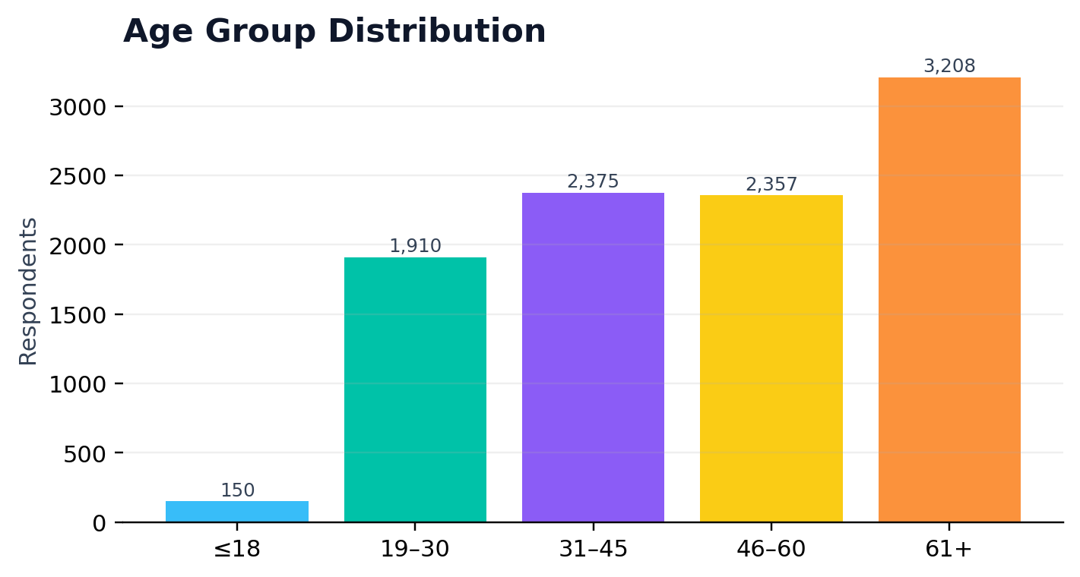
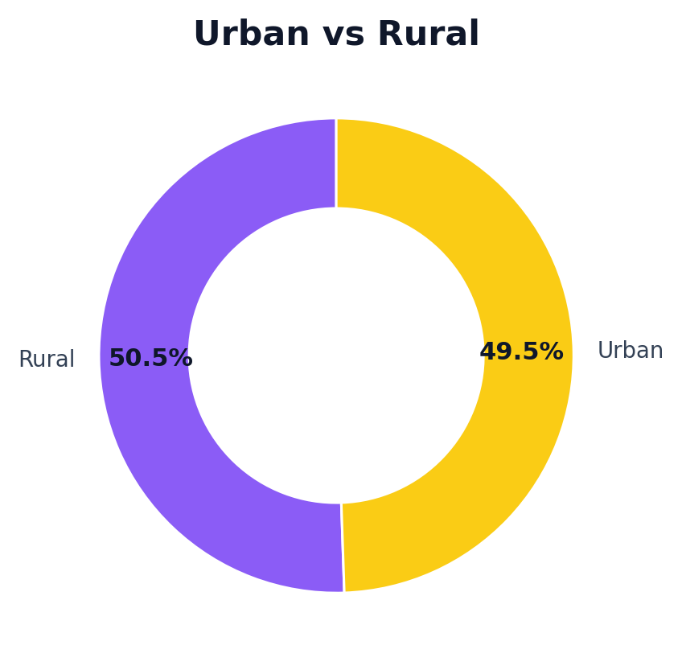
Demographic Profile
Age, gender and location
Age group distribution
Gender split
Urban/rural split
Profile Reading
• The average age is 49.1 years, with a median age of 49 years.
• Gender distribution is almost balanced: 50.6% male and 49.4% female.
• Urban and rural records are also near balanced: 49.5% urban and 50.5% rural.
Source: powerbi_india_demographics_sample.csv | Sample analysis for presentation
05

Slide 5
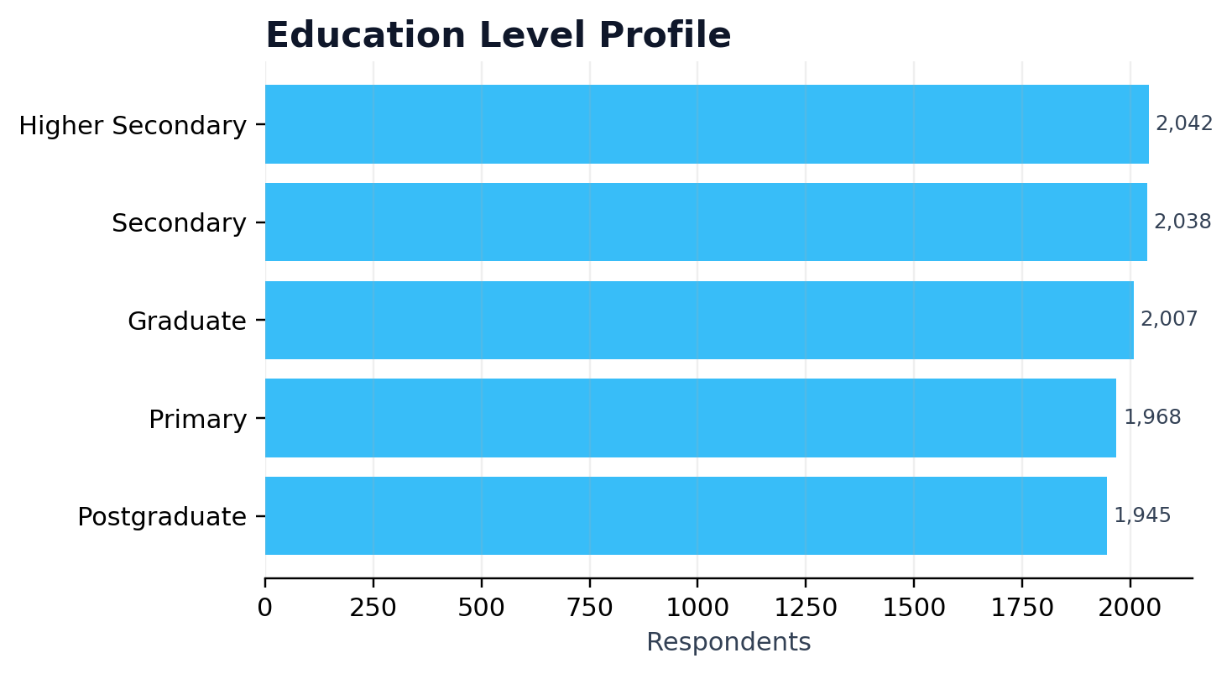
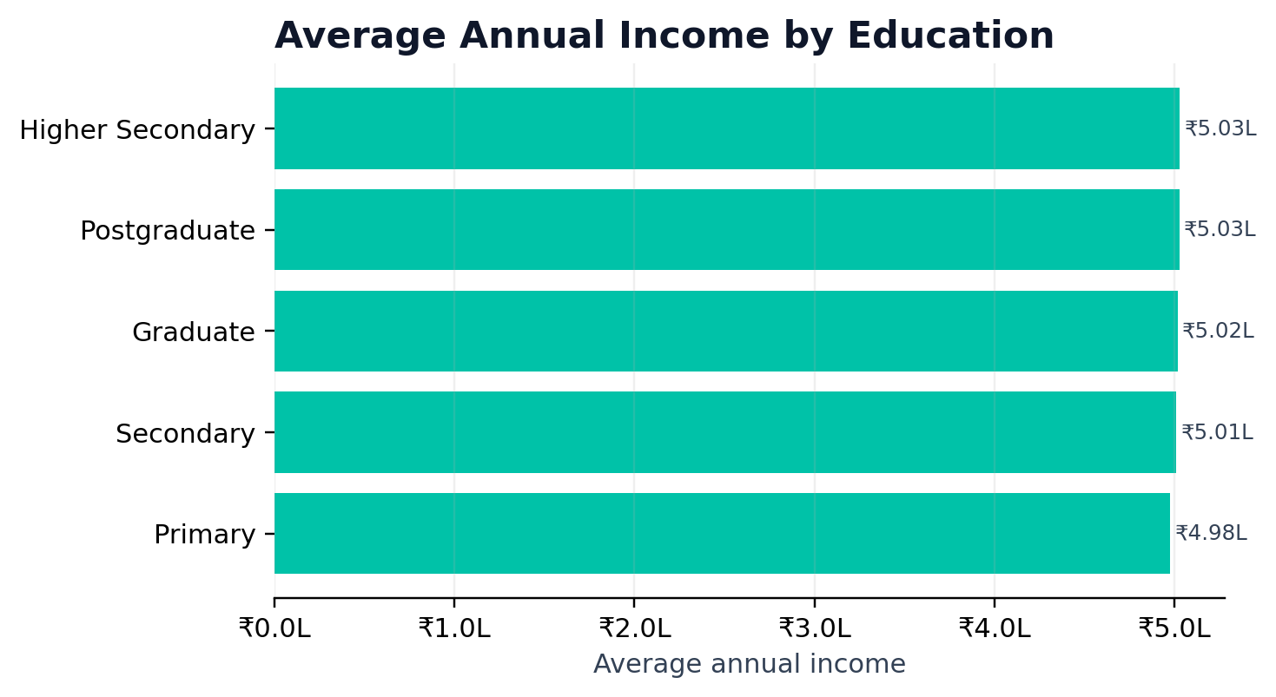
Education & Income Profile
Qualification mix and earning pattern
Education distribution
Average income by education
Insight: Higher Secondary is the largest education category (2,042 records). Average income is fairly close across education groups; Higher Secondary is highest at ₹5.03L.
Source: powerbi_india_demographics_sample.csv | Sample analysis for presentation
06

Slide 6
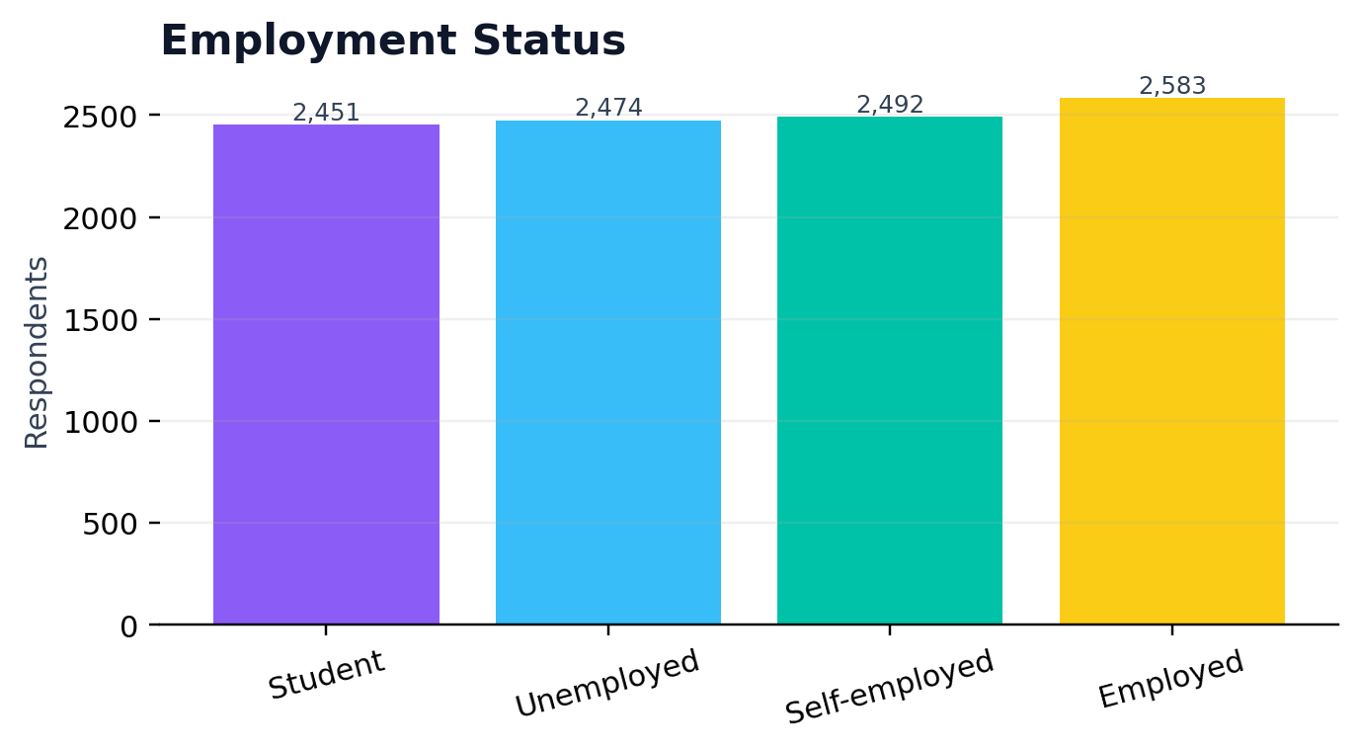
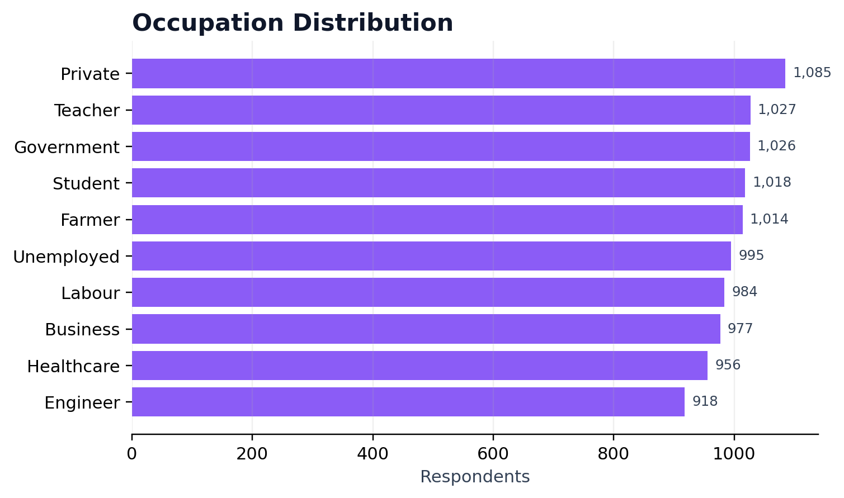
Employment & Occupation View
Workforce profile
Employment status
Occupation distribution
Insight: Employed is the largest employment group (2,583 records). Private is the most common occupation in the sample (1,085 records).
Source: powerbi_india_demographics_sample.csv | Sample analysis for presentation
07

Slide 7
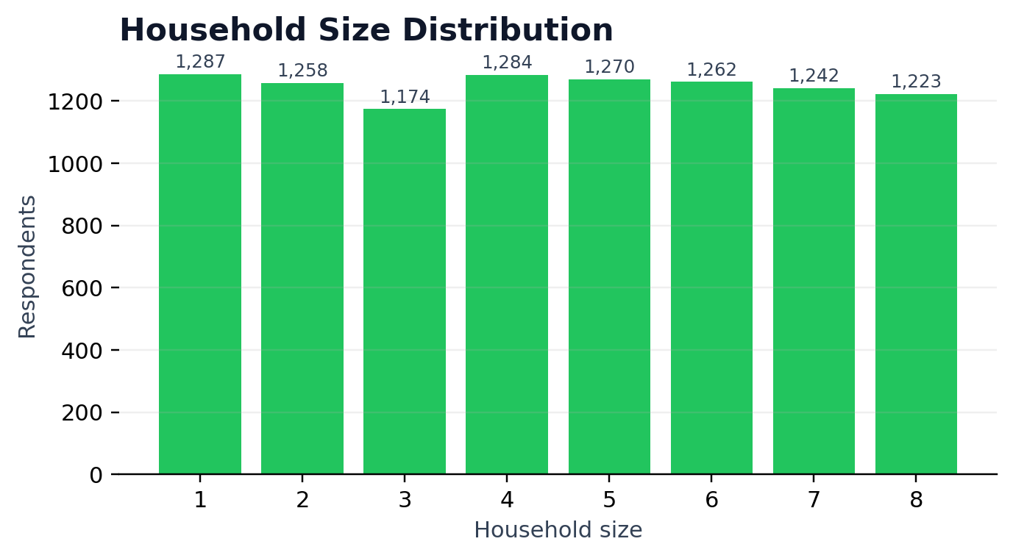
Household Profile
Family size and demographic context
Household size distribution
Household Signals
AVERAGE SIZE
MAX SIZE
4.49
8
members
members
MIN SIZE
MEDIAN SIZE
1
4
member
members
Household size is useful for comparing income, access, and demographic dependency patterns in future Power BI dashboards.
Source: powerbi_india_demographics_sample.csv | Sample analysis for presentation
10

Slide 8
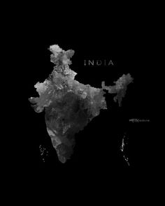
Key Insights & Recommendations
What to highlight in presentation
Key Insights
Punjab has the highest number of records (1,044), while Rajasthan has the lowest (943), indicating differences in the dataset's population distribution across states.
Gujarat has the highest average annual income (≈ ₹5.10 lakh), whereas Punjab has the lowest (≈ ₹4.91 lakh), showing income variation between states.
The gender distribution is almost balanced, with 5,058 males and 4,942 females, indicating an evenly represented dataset.
Higher Secondary education is the most common education level, followed closely by Secondary and Graduate, showing that most individuals have at least a secondary-level education.
Source: powerbi_india_demographics_sample.csv | Sample analysis for presentation
11

Slide 9
Thank You
India Demographics Analysis
The dataset has been transformed into a professional presentation with executive KPIs, charts, insights, and recommendations suitable for academic submission or Power BI project explanation.
Source: powerbi_india_demographics_sample.csv

